Slide 1
DATA WAREHOUSE DESIGN – DIMENSIONAL MODELING
Quách Đình Hoàng
hoangqd@fit.hcmute.edu.vn

Slide 2
Outline
Dimensional Modeling Concepts
Dimensional Modeling Process
Types of Fact Tables
Types of Facts
Slowly Changing Dimensions

Slide 3
Dimensional Modeling Concepts
Dimensions
Facts
Dimensional Model or Star Schema
Conformed Dimensions
Data Warehouse Bus Matrix

Slide 4
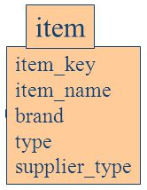
Dimensions
Set of attributes (columns) related to a subject/object
Who, what, when, where, why, how
Ex: Product, Customer, Date, Vendor, …
Each dimension row is a unique occurrence
One row per product, customer, day, …
Dimension attributes
Report labels and query constraints
“By” words and “where” clauses
Verbose descriptive attributes, in addition to codes
Hierarchical relationships

Slide 5
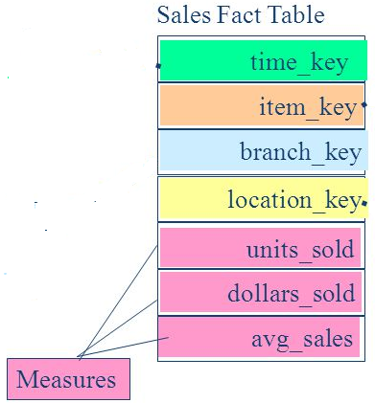
Facts
Result from a business process or business event
Facts are usually numeric and additive
Granularity/grain
Identifies the fact level of detail
One row per sale, one row per service call, one row per claim, …
Atomic grain is most flexible

Slide 6
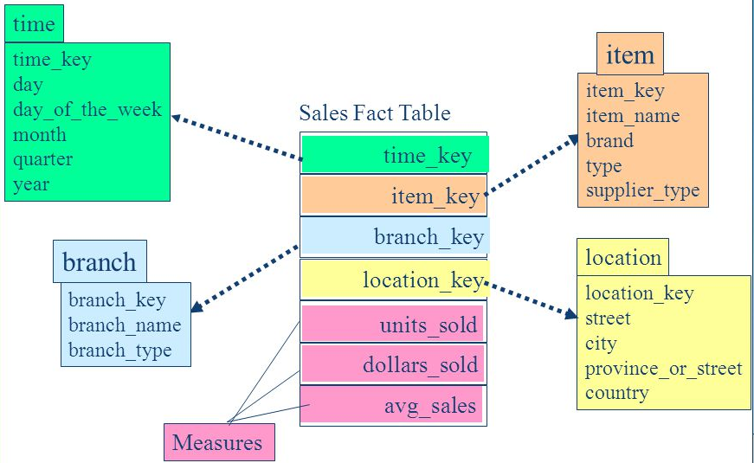
Star Schema
Fact table per business process/event, plus relevant dimensions
Benefits
Easier to understand
Better performance from fewer joins
Extensible to handle change
Dimension Tables
Fact Table
Dimension Tables

Slide 7
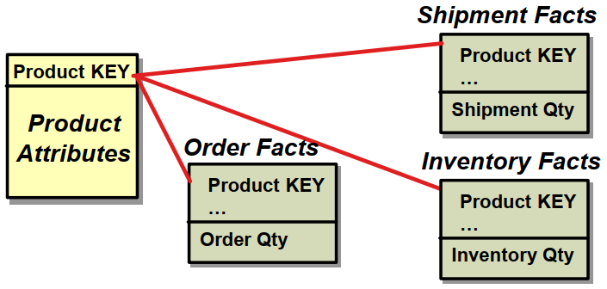
Conformed Dimensions
Shared across business processes (fact tables) in the DW.
All fact tables use same standard dimensions
Established via Bus Matrix, enforced in ETL

Slide 8
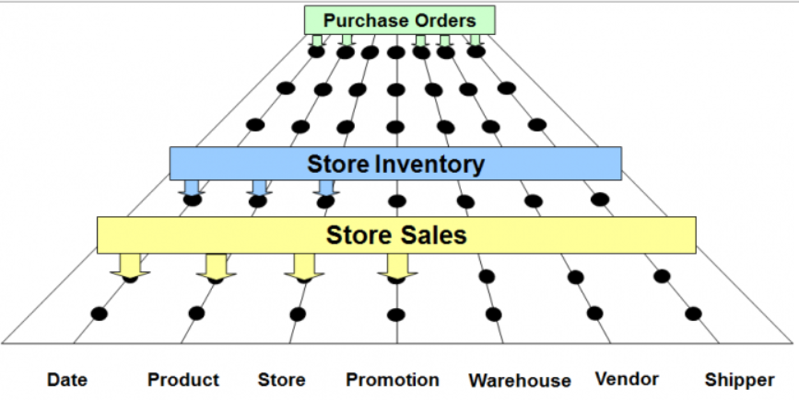
Enterprise Data Warehouse Bus Architecture

Slide 9
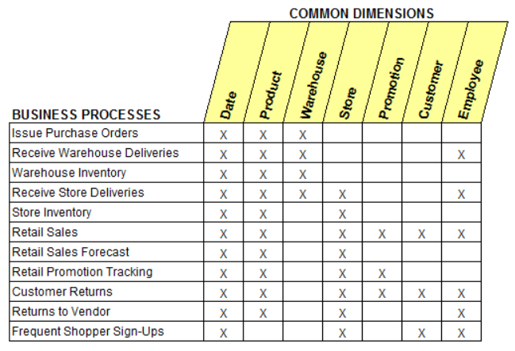
Data Warehouse Bus Matrix
Rows = Business processes
Columns = Conformed dimensions

Slide 10
Dimensional Modeling
A Logical design technique for structuring data with the following objectives:
Intuitive: Easy for business users to understand
Fast: Excellent query performance
Think of a Dimensional Model as a fact table + the dimensions it requires.
Dimensional Models are implemented in the Relational DBMS as star schemas and in MOLAP databases as cubes.
Notes:
Remember one of the key reasons the discipline of data warehousing exists, is that the STRUCTURE of data we have in our transactional systems is not very conducive to ad-hoc querying and analytics. The goal of dimensional modeling is to re-shape our data into a form more queryable by end-users.

Slide 11
Components of the Dimensional Model
Fact Table – A database table of quantifiable performance measurements (facts).
Originate from business processes.
Has FK’s to each of the dimensions.
Ex. Sales Amount, Days To Ship, Quantity on Hand.
Dimension Table – A table of contexts for the facts.
Ex. Date/Time, Location, Customer, Product
Attribute – A characteristic of a dimension.
Ex. Product: Name, Category, Department
Star Schema – Connections among facts and dimensions which define a business process.
Ex: Sales, Inventory Management

Slide 12
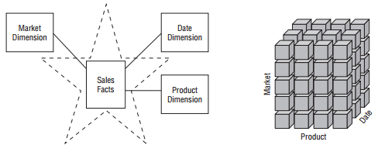
Multidimensional Data Representations
Star schema
OLAP cube

Slide 13
Modeling data warehouses
A data warehouse is based on a multidimensional data model which views data in the form of a data cube
A data cube, such as sales, allows data to be modeled and viewed in multiple dimensions
Dimension tables, such as item (item_name, brand, type), or time(day, week, month, quarter, year)
Fact table contains measures (such as dollars_sold) and keys to each of the related dimension tables

Slide 14
Modeling data warehouses
Modeling data warehouses: dimensions & measures
Star schema: A fact table in the middle connected to a set of dimension tables
Snowflake schema: A refinement of star schema where some dimensional hierarchy is normalized into a set of smaller dimension tables, forming a shape similar to snowflake
Fact constellations: Multiple fact tables share dimension tables, viewed as a collection of stars, therefore called galaxy schema or fact constellation

Slide 15
Star Schema Example
time
time_key
day
day_of_the_week
month
quarter
year
item
item_key
item_name
brand
type
supplier_type
Sales Fact Table
time_key
item_key
branch_key
branch
location
location_key
branch_key
branch_name
branch_type
location_key
street
city
state_or_province
country
units_sold
dollars_sold
avg_sales
Measures
Notes:
The Star Schema Is a Relational Database Implementation Of A Dimensional Model

Slide 16
Snowflake Schema Example
time
item
time_key
day
day_of_the_week
month
quarter
year
item_key
item_name
brand
type
supplier_key
supplier
Sales Fact Table
supplier_key
supplier_type
time_key
item_key
branch_key
branch
location
location_key
location_key
street
city_key
branch_key
branch_name
branch_type
units_sold
dollars_sold
city
city_key
city
state_or_province
country
avg_sales
Measures

Slide 17
Constellation Schema Example
time
time_key
day
day_of_the_week
month
quarter
year
item
Shipping Fact Table
item_key
item_name
brand
type
supplier_type
Sales Fact Table
time_key
time_key
item_key
shipper_key
item_key
branch_key
from_location
branch
location_key
location
to_location
branch_key
branch_name
branch_type
units_sold
location_key
street
city
province_or_state
country
dollars_cost
dollars_sold
units_shipped
avg_sales
shipper
Measures
shipper_key
shipper_name
location_key
shipper_type

Slide 18
Dimensional Modeling Process
Develop the Data Warehouse Bus matrix
Follow the 4-step method to define fact and dimension
Step 1: Identify the business process (matrix row)
Step 2: Declare the grain
Step 3: Identify the dimensions
Step 4: Identify the facts
Diagram the dimensional model
Fill the dimension and fact attributes

Slide 19
#1: Identifying Business Processes
3 type of business processes (fact table)
Events or Transactions
Workflows a.k.a. Accumulating Snapshots
Points in time a.k.a Periodic Snapshots
Business processes contain facts which we use end up being the fact tables in our ROLAP star schemas.
Transaction
Accumulating Snapshot
Periodic Snapshot

Slide 20
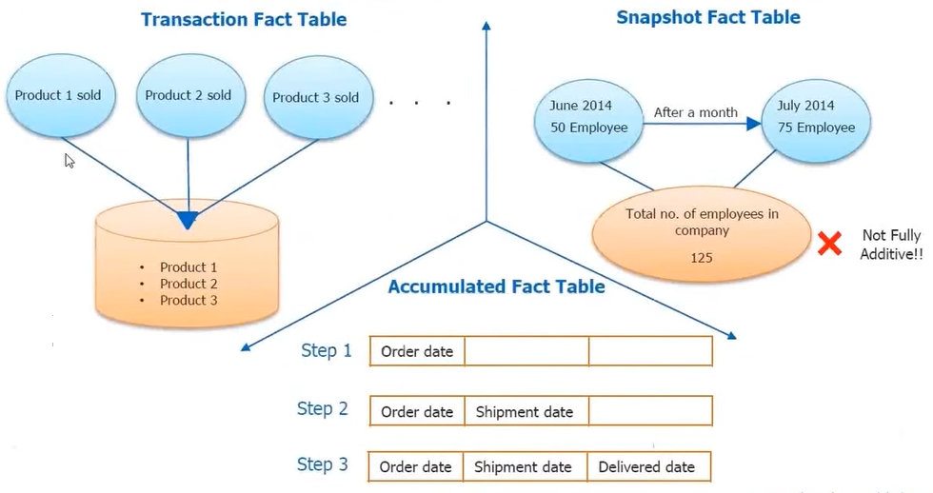
Types of Fact Table

Slide 21
Transaction Fact
The most basic fact grain
One row per line in a transaction
Corresponds to a point in space and time
Once inserted, it is not revisited for update
Rows inserted into fact table when transaction or event occurs
Examples
Sales, Returns, Telemarketing, Registration Events

Slide 22
Accumulating Snapshot Fact
Less frequently used, application specific.
Used to capture a business process workflow.
Fact row is initially inserted, then updated as milestones occur
Fact table has multiple date FK that correspond to each milestone
Special facts: milestone counters and lag facts for length of time between milestones
Examples:
Order fulfillment, Job Applicant tracking, Rental Cars

Slide 23
Periodic Snapshot Fact
At predetermined intervals snapshots of the same level of details are taken and stacked consecutively in the fact table
Snapshots can be taken daily, weekly, monthly, hourly, etc…
Complements detailed transaction facts but does not replace them
Share the same conformed dimensions but has less dimensions
Examples:
Financial reports, Bank account values, Semester class schedules, Daily classroom Lab Logins, Student GPAs

Slide 24
Which Fact Table?
Concert ticket purchases?
Voter exit polls in an election?
Mortgage loan application and approval?
Auditing software use in a computer lab?
Daily summaries of visitors to websites?
Tracking Law School applications?
Attendance at sporting events?
Admissions to sporting events at 15 minute intervals?
Transaction
Accumulating Snapshot
Periodic Snapshot

Slide 25
#2: Declare the grain
Grain is the level of detail stored in the data warehouse
Do we store all products or just product categories
Each month, week, day, or hour
Grain impact on the size of the data warehouse
Typically implement the lowest possible dimension grain
We can aggregate in many different ways

Slide 26
#3: Identify the Dimensions
Dimensions provide context for our facts.
We can easily identify dimensions because of the “by” and/or “for” words.
Ex. Total accounts receivables for the IT Department by Month.
Dimensions have attributes which describe and categorize their values.
Ex. Student: Major, Year, Dormitory, Gender.
The attributes help constrain and summarize facts.

Slide 27
#4 Identify the Facts
Facts are quantifiable numerical values associated with the business process.
How much?
How many?
How long?
How often?
If its not tied to the business process, its not a fact.
For example:
Points Scored == Fact

Slide 28
Types of Facts
Additive - Fact can be summed across all dimensions
The most useful kind of fact.
Quantity sold, hours billed.
Semi-Additive - Fact cannot be summed across all dimensions, such as time periods.
Sometime these are averaged across the time dimension.
Quantity on Hand, Time logged on to computer.
Non-Additive - Cannot be summed across any dimension.
These do not belong in the fact table, but with the dimension.
Basketball player height, Retail Price

Slide 29
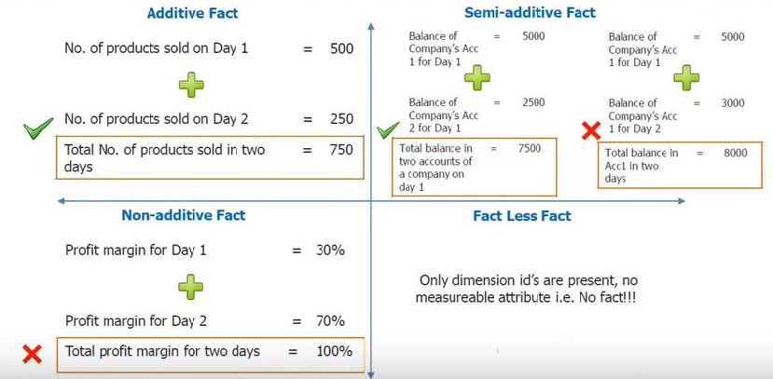
Types of Fact

Slide 30
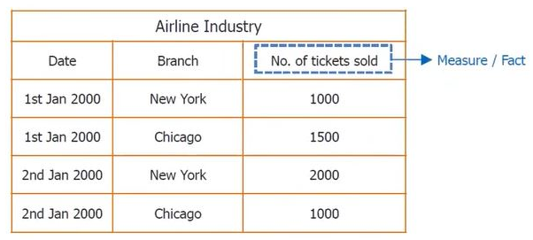
Addictive Fact
Airline Industry Fact
Dimensions: Date and Branch
Measure: Number of ticket sold

Slide 31
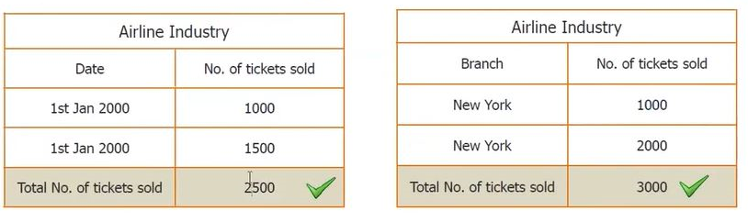
Addictive Fact
Sum across Date Dimension
Sum across Branch Dimension

Slide 32
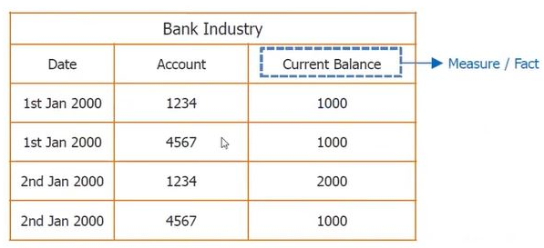
Semi-addictive Fact
Bank Industry Fact
Dimensions: Date and Account
Measure: Current Balance

Slide 33
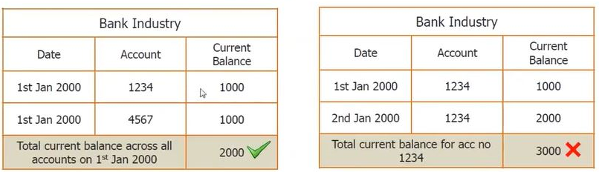
Semi-addictive Fact
Sum across Date Dimension
Sum across Account Dimension

Slide 34
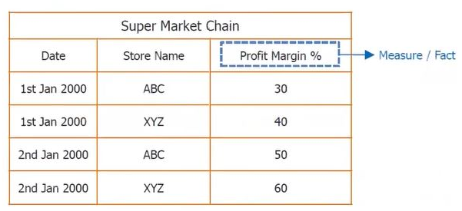
Non-addictive Fact
Supper Market Chain Fact
Dimensions: Date and Store
Measure: Profit Margin

Slide 35
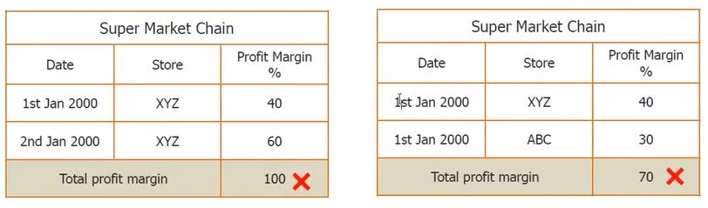
Non-addictive Fact
Sum across Date Dimension
Sum across Store Dimension

Slide 36
Which Fact? Additive? Semi? Non?
Number of page views on a website?
The amount of taxes withheld on an employee’s monthly paycheck?
Credit card balance.
Pants waist size? 32, 34, etc…
Tracking when a student attends class?
Product Retail Price?
Vehicle’s MPG rating?
The number of minutes late employees arrive to work each day.

Slide 37
Dimensional Modeling Practice
Identify: Business Process, Fact and Dimensions
What’s the total amount of product shipped by sales region for 2010-2014?
What’s the average time in days for a student’s application to be processed?
How many employees wait more than 15 minutes for a bus to the Manley parking lot?

Slide 38
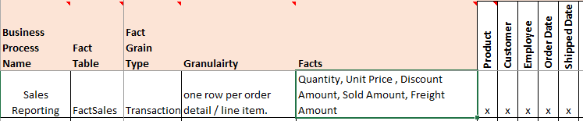
Enterprise Bus Matrix
A key deliverable from requirements gathering, the bus matrix documents your business processes, grain, dimensions, and facts across all projects in your program.

Slide 39
Build A Bus Matrix
Identify business processes
Transaction, Periodic Snapshot or Accumulating Snapshot
Declare the grain
The level of detail stored in the data warehouse
Identify the dimensions
The context for our facts
Identify facts
Should be Additive, or at least Semi-Additive

Slide 40
The Dimension Table Key
Surrogate keys (identities, sequences e.g. 1,2,3,…) are used for the primary key constraint.
They yield best performance for the Star Schema
most efficient joins,
smaller indexes in fact table,
more rows per block in the fact table
They have no dependency on primary key in operational source data
Makes it easier to deal with changes to the source data
Dimension table requires a natural key or business key to identify a unique row
Ex: Customer’s email address, Employee’s ID number.

Slide 41
Date and Time Dimensions
Just about every fact table as a date and/or time dimension.
This is the most common of conformed dimensions
Usually generated programmatically during the ETL process or imported from a spreadsheet.
Acceptable to use PK in the form YYYYMMDD (int)
In you need time of day, use a separate dimension.
Time of day should only be used if there are meaningful textual descriptions of time
Ex. Lunch, Dinner, 1st shift, 2nd Shift, Etc…
Elapsed times intervals are facts, not attributes.
Ex. Minutes between when order was received and shipped

Slide 42
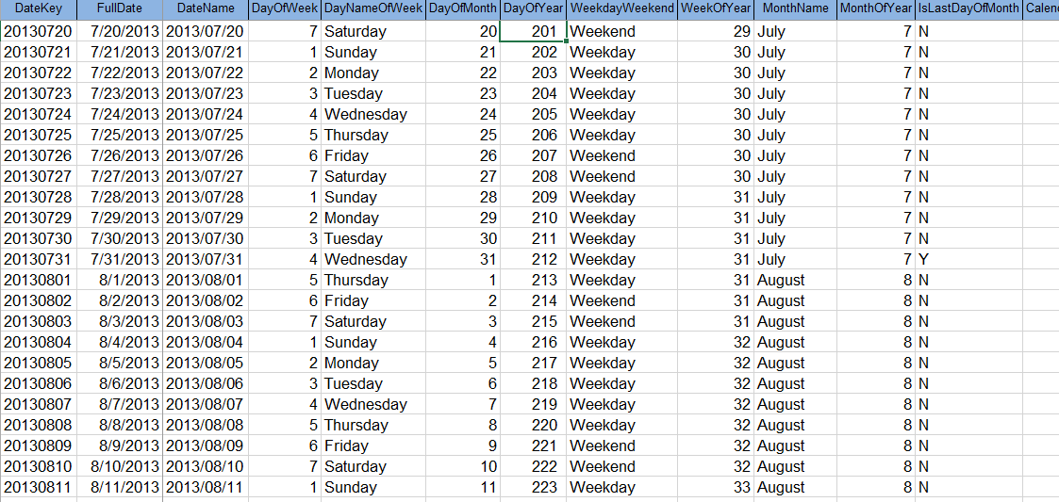
Date Dimension Example

Slide 43
Degenerate Dimensions
Dimensions we store in the fact table, because there’s too many of them for their own a dimension
For example a 1-1 relationship from fact to dimension
These occur in transaction fact tables that have a parent child (One to Many) structure
Ex. Order → Order Detail,
Airline Ticket → Flights
Allow us to drill-through to operational data, in the ODS.
Usually ends up as part of the primary key of the fact table.

Slide 44
Slowly Changing Dimensions
Dimensional data changes infrequently but when it does you need a strategy for addressing the change.
Ex: What happens when a customer has a new address, or an Employee has a name change?
4 Popular strategies
Type 1: Overwrite the existing attribute
Type 2: Add a new Dimension row
Type 3: Add a new Dimension attribute -
Mini-Dimension: Add a new Dimension
These strategies are not mutually exclusive, and can be combined.

Slide 45
Type 1: Overwrite
Appropriate for
correcting mistakes or errors in data
changes where historical associations do not matter
the old value has no significance
If the previous value matters, don’t use this strategy.
You are rewriting history
Problems will occur with data aggregated on old values.
Ex. Employee Name Changes, Corrections, Natural Key Edits.

Slide 46
Type 2: Add New Dimension Row
Most popular strategy, as it preserves history
Natural key is repeated
Old and new values are stored along with effective dates and indicator of which row is “current”
Product Key | Product Descr. | Product Code | Department | Effective Date | Expiration Date | Current Row
11981 | Stapler, Red | ST901 | Accessories | 4/7/2010 | 9/1/2011 | N
20344 | Stapler, Red | ST901 | Supplies | 9/2/2011 | 3/31/2013 | N
45393 | Stapler, Red | ST901 | Office Supplies | 4/1/2013 | 12/31/9999 | Y
The Change

Slide 47
Type 3: Add A New Dimension Attribute
Infrequently used, preserves history
Useful for “soft” changes where users might want to choose between the old and new attribute, or need to access both values for a time
The new value is written to the existing column, the old value is stored in a new column
This way queries do not have to be re-written to access the new attribute
Ex. Redistricting sales territories. Re-charting accounting codes

Slide 48
Mini-Dimensions: Add a new Dimension
If attributes change frequently consider placing them in their own “mini-dimensions”
Most effective when you have banded values, or ranges of discrete values
Customer Dimension
Customer key PK
Customer ID (Nat. Key)
Customer Name
…
Fact Table
Customer Key FK
Customer Demographics Key FK
… other FKeys…
… Facts…
Customer Demographics Dimension
Customer Demographics Key PK
Customer Age Band
Customer Gender
Customer Income Band
…

Slide 49
Summary
Dimensional Modeling Concepts
Dimensional Modeling Process
Types of Fact Tables
Types of Facts
Slowly Changing Dimensions

